Slide 1

Locked In
Stevie Siy
CYBR 8480

Slide 2
Project Overview

Slide 3
Project Goals
Overall Goal
Peace of Mind for Homeowners
Physical Goals
Secure Entrances with Motion Sensor Device
Log Unauthorized Entrances for Reference

Slide 4
Physical Components
Hardware
Raspberry Pi running Node-RED Server
HC-SR04 or HC-SR05 Ultrasonic Distance Sensor
Software
Locked In Mobile App
Node-RED Flow to Collect Data

Slide 5
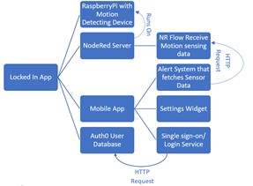
High Level Design

Slide 6
Component List
Raspberry Pi
Node-RED Server
Mobile App
Auth0 User Database

Slide 7
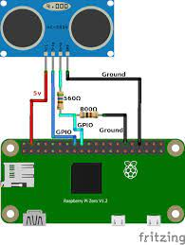
Raspberry Pi
Connected to HC-SR04/HC-SR05 Attachment
Running Node-RED Server

Slide 8
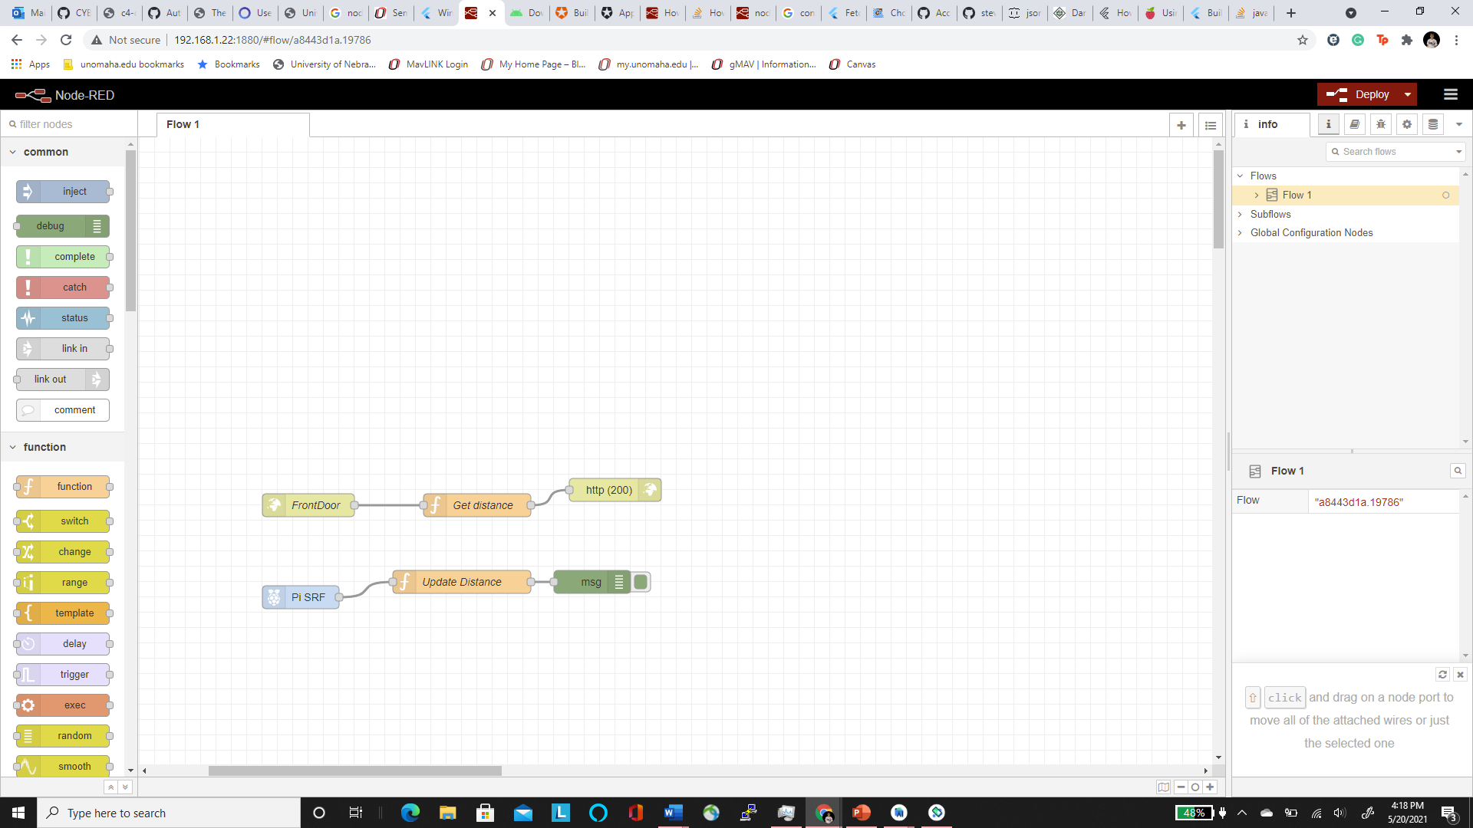
Node-RED Server

Slide 9
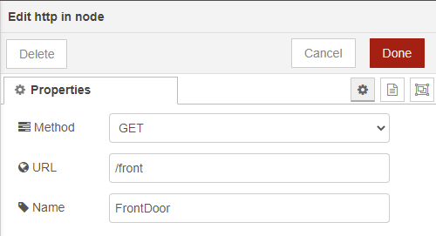
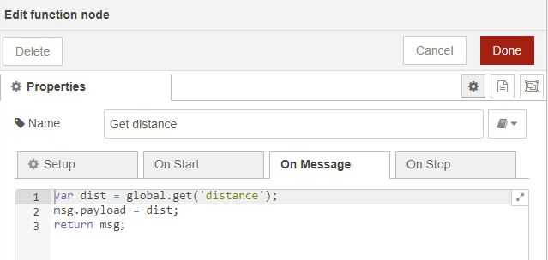
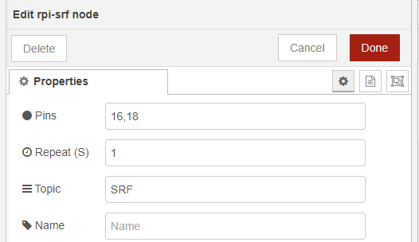

Flow Settings

Slide 10
Auth0 User Database

Slide 11
Mobile App
Alert System
Settings Widget
Login Widget

Slide 12
Demonstration

Slide 13
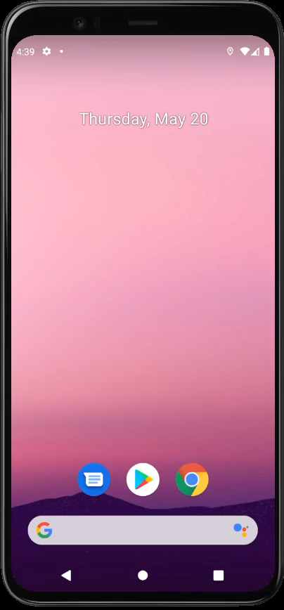

Slide 14
Testing

Slide 15
Thank you for Viewing

